Slide 1
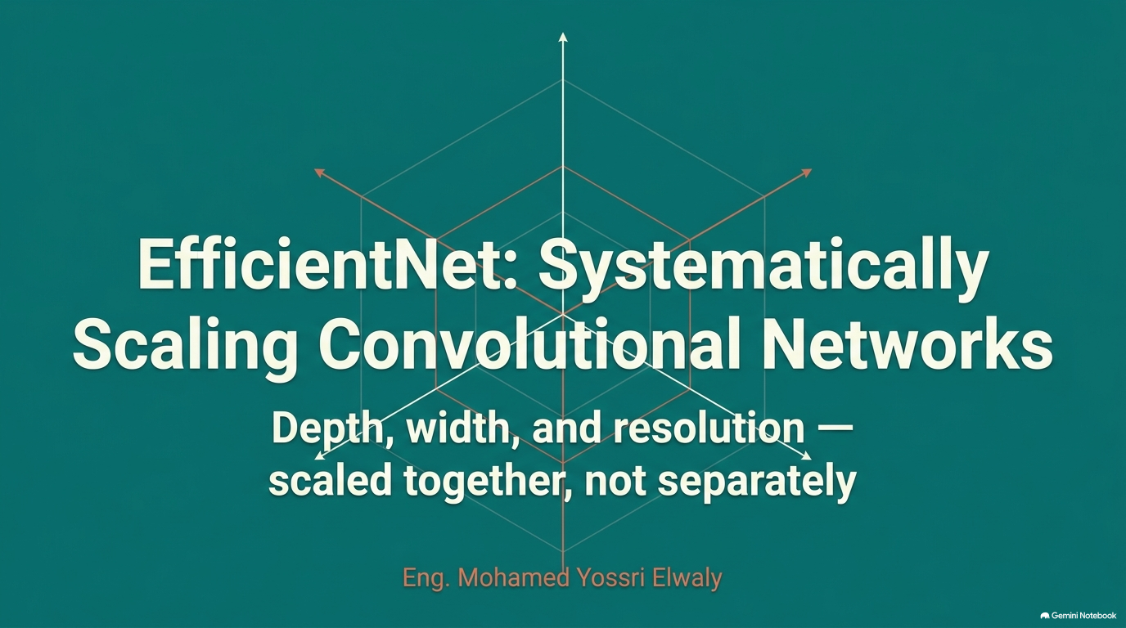

Slide 2
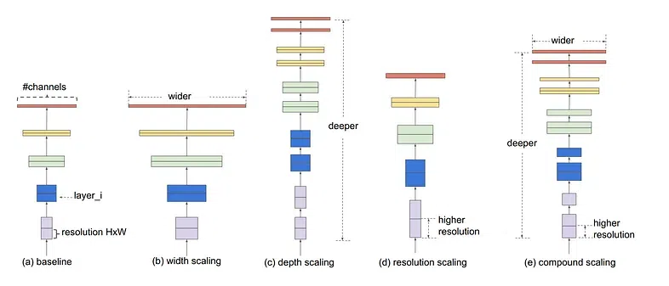

Slide 3
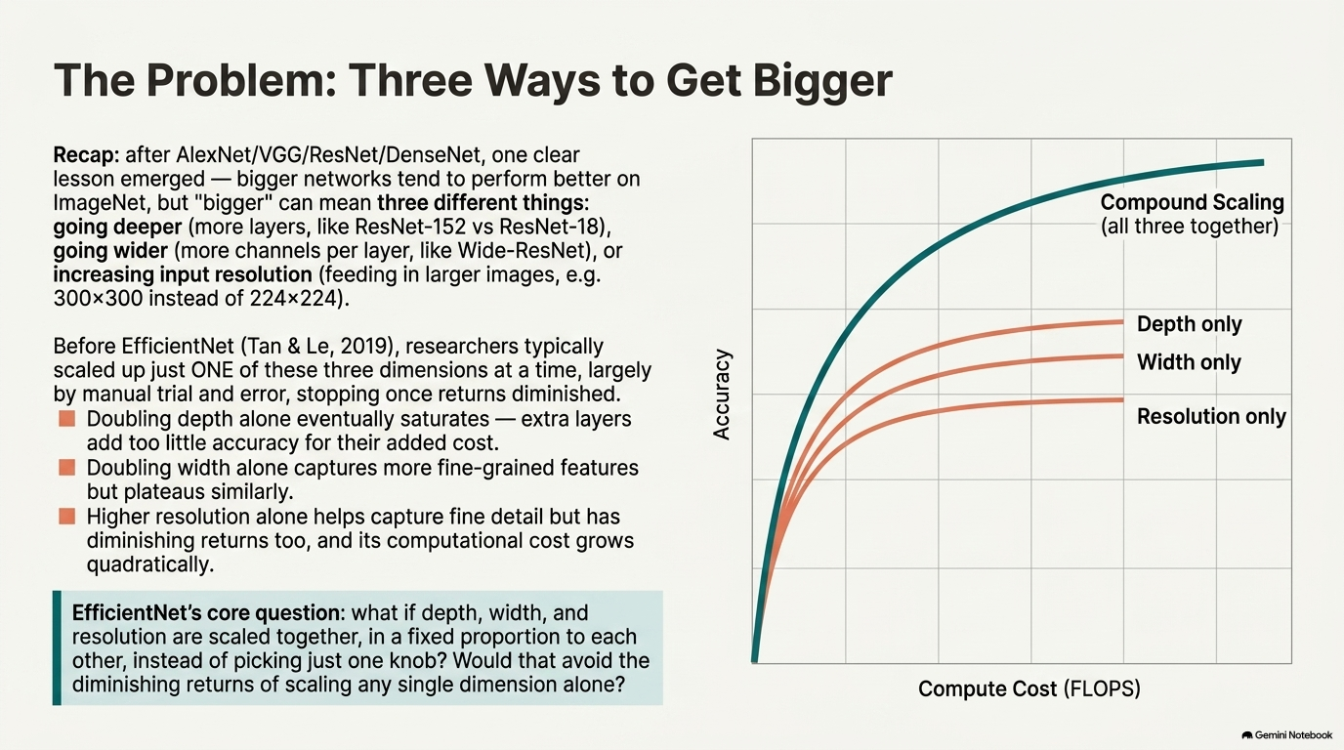
Eng. Mohamed Yossri Elwaly

Slide 4
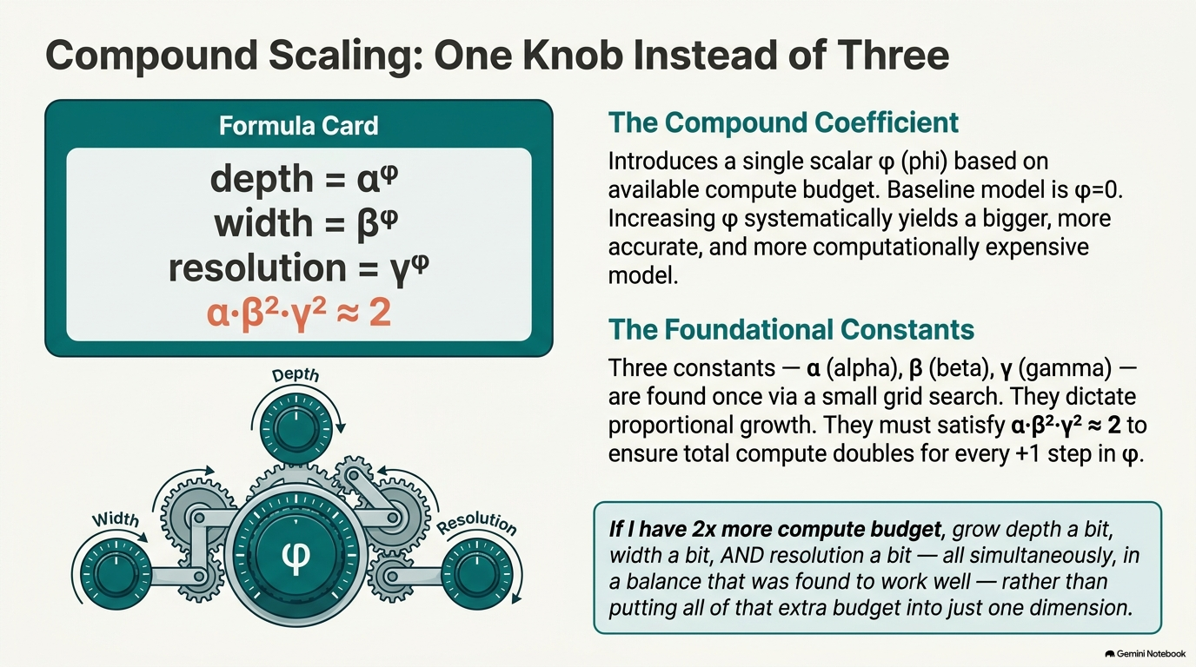

Slide 5
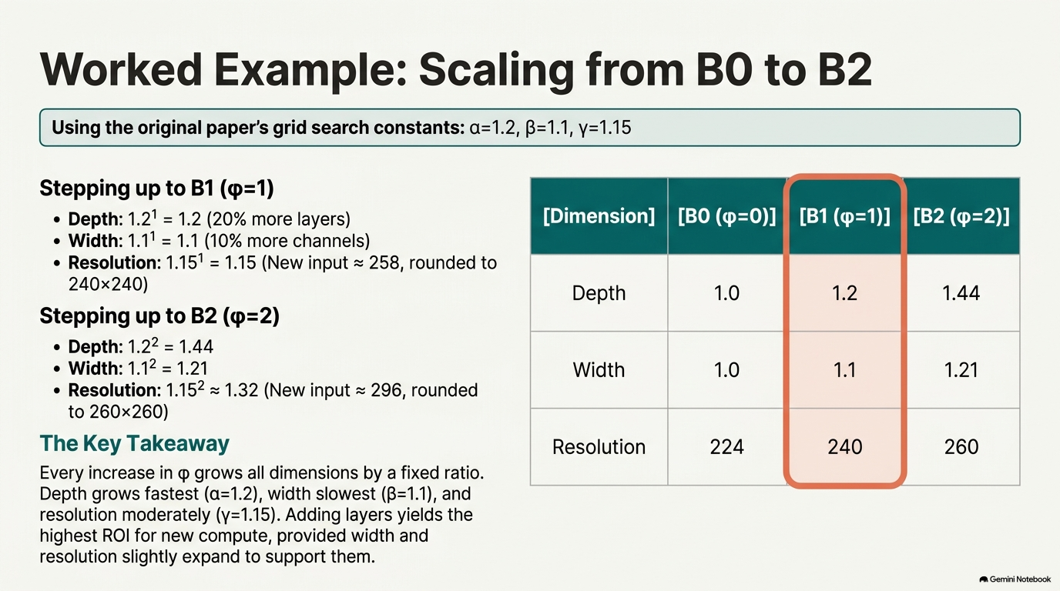
Eng. Mohamed Yossri Elwaly

Slide 6
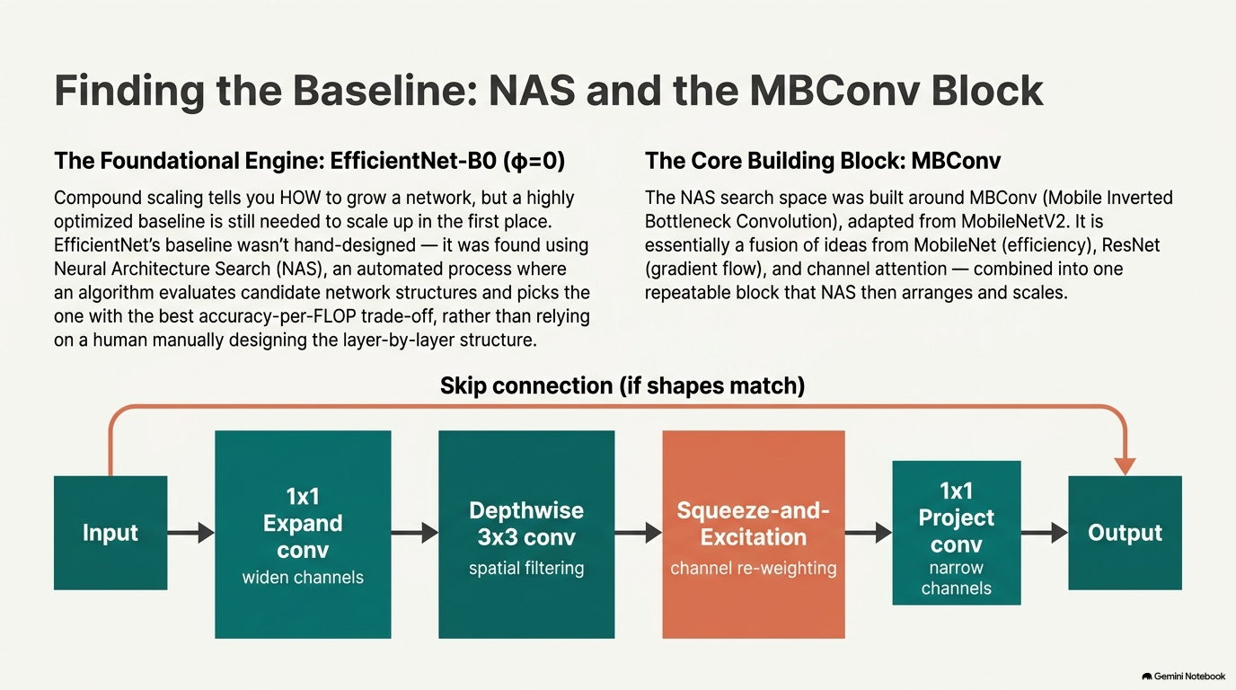
Eng. Mohamed Yossri Elwaly

Slide 7
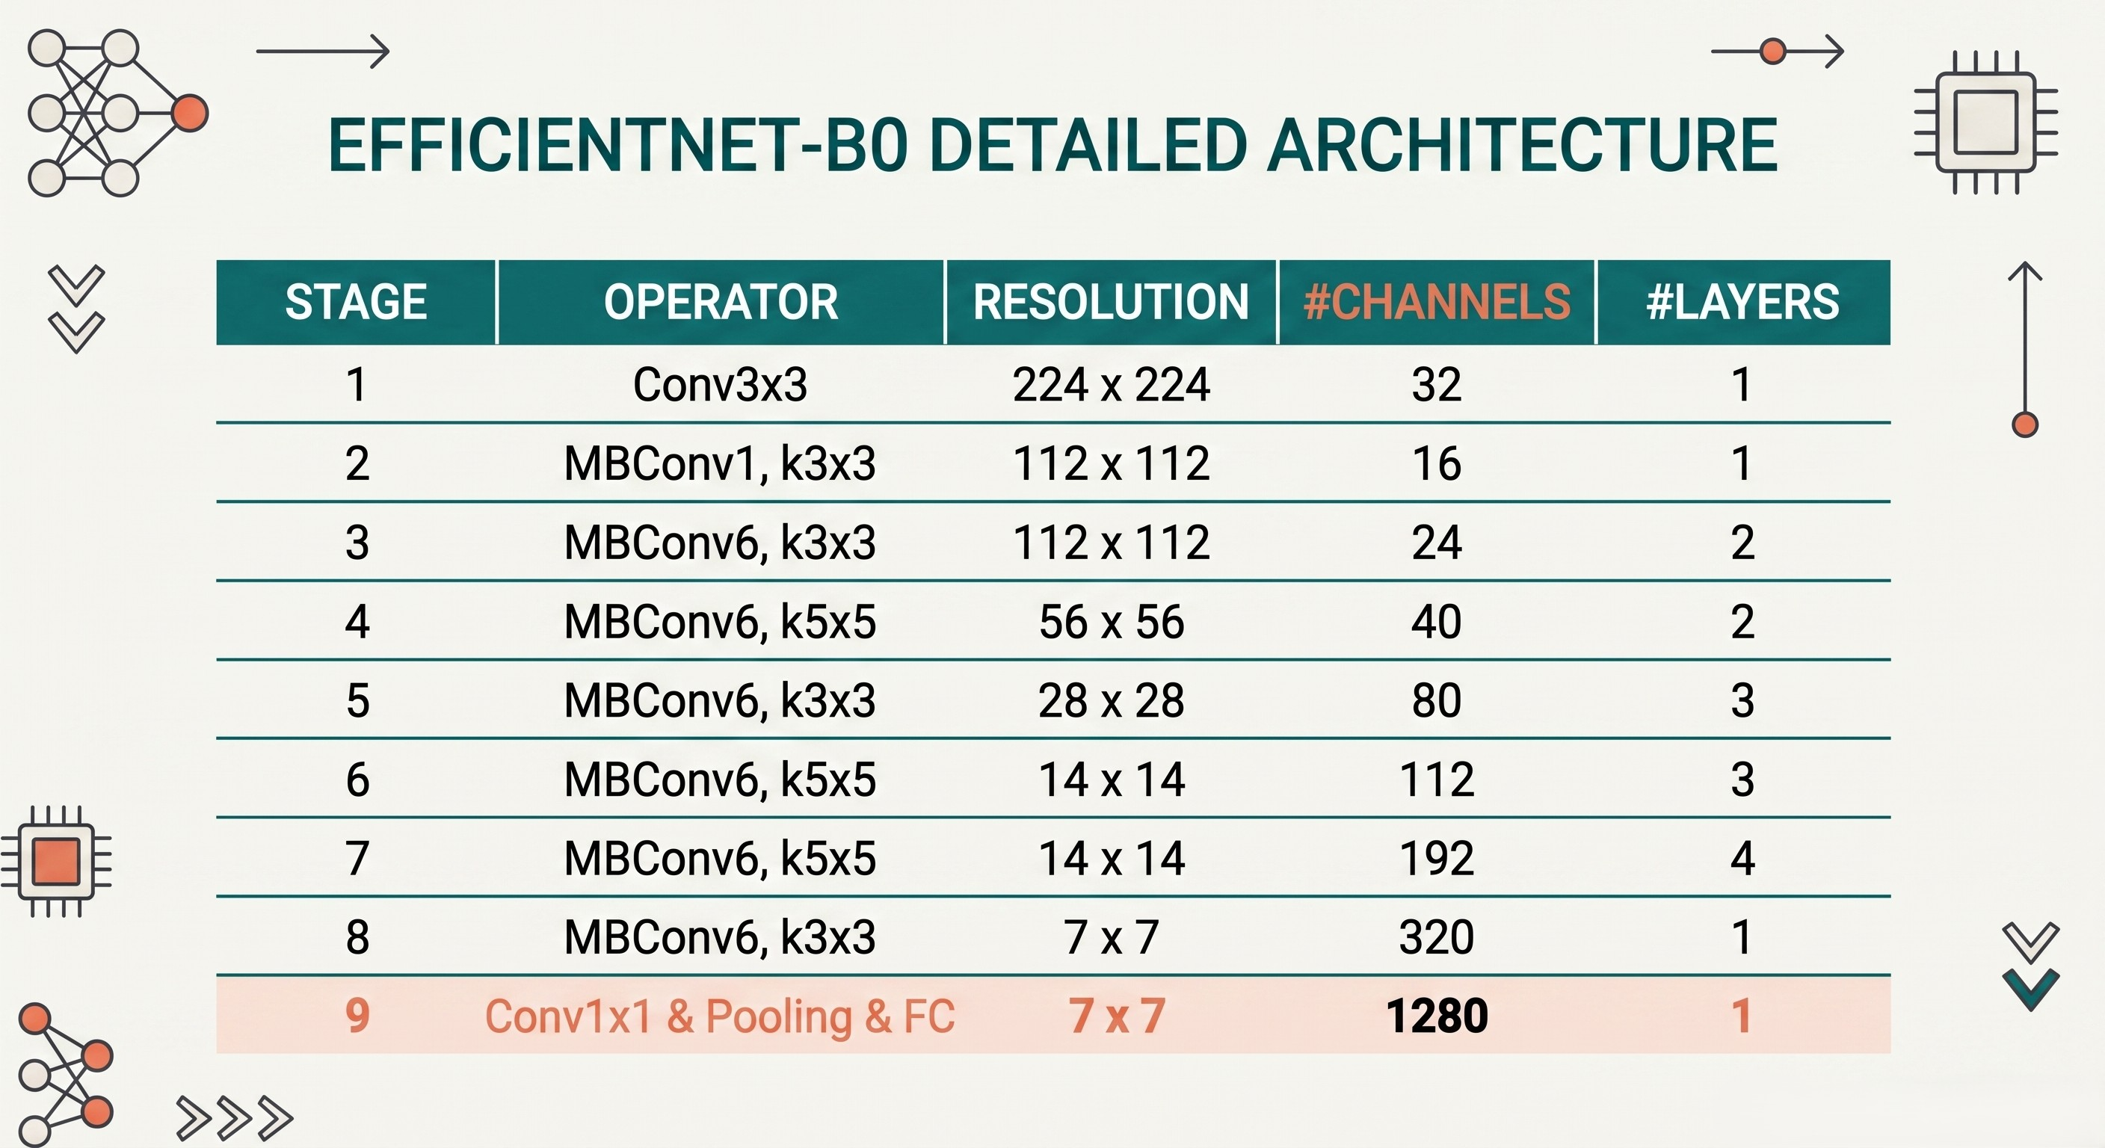
Eng. Mohamed Yossri Elwaly

Slide 8
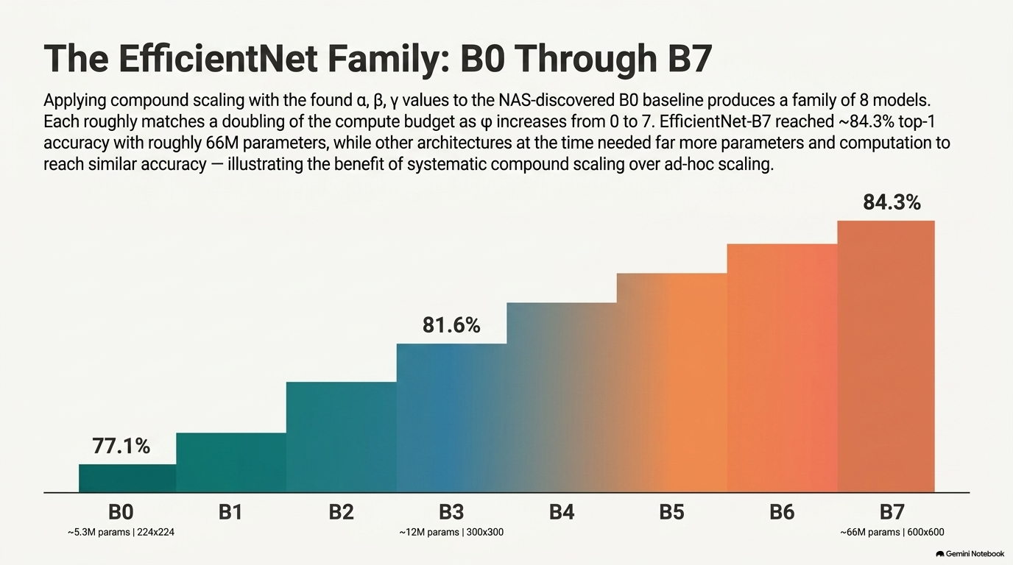
Eng. Mohamed Yossri Elwaly

Slide 9
